Slide 1




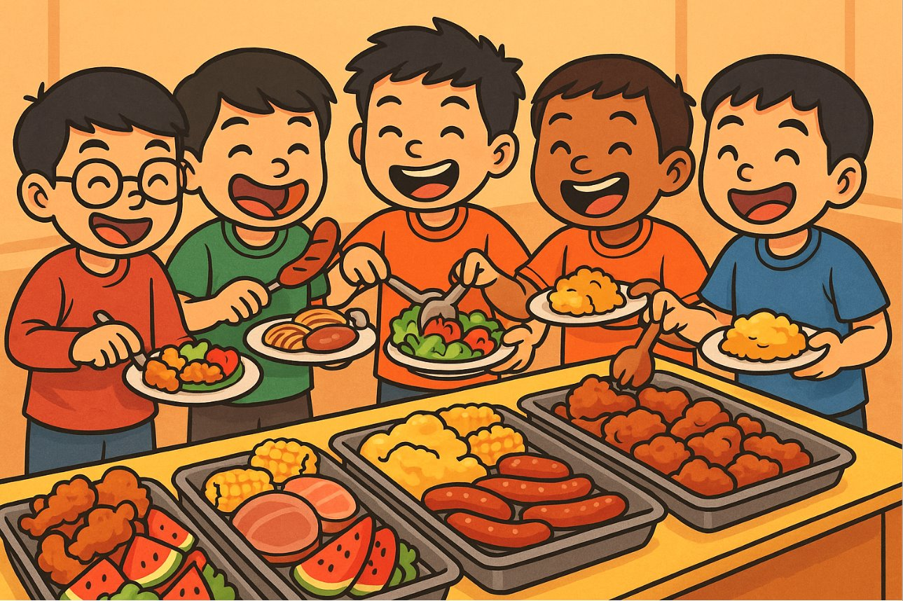


Buffet Optimization: High Steaks Forecasting
Group 2:
Alan Chang Jia Jie
Andre Ong Jia Kang
Ng Jin Yao
Nor Hendra Bin Abdul Rahman
Shaun Neo Rong Jo

Slide 2

Table of contents
01
Problem Statement Recap
02
Module 1: How resilient is my business to cost fluctuations and the optimal pricing
03
Module 2: How to strategise my pricing for marketing decisions
04
Module 3: How to maintain customers’ satisfaction
05
Module 4: How to optimize manpower
06
Insights and recommendations

Slide 3
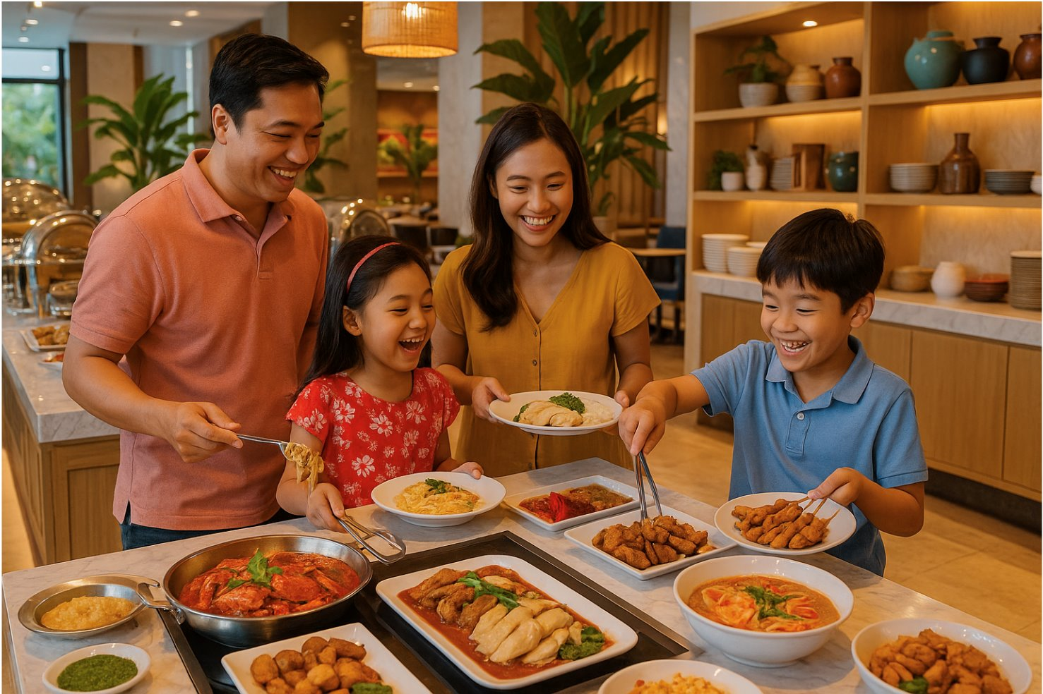
Problem Statement
Singaporeans live for food. This fact is nowhere more evident
than in our nation’s vibrant buffet scene. Yet even our most
celebrated hotel buffets struggle to turn that passion into
optimal performance. ​
​
Key challenges faced in the F&B industry:
Rising ingredient costs,
Tight labor market,
Declining consumer demands,
Narrowing profit margins,
More competitors
​
In this project, our team assumes the role of an operator for a
buffet restaurant located in a 5-star hotel. As such, the goal
is to develop a data-driven framework to tackle the challenges
in the F&B industry and optimize our operations.
Common Assumptions for Project
Opening Hours: Lunch (12-2.30pm, 2.5hrs) and Dinner (6-10pm, 4hrs) Dining Time: 90 minutes
Max capacity: 260 seats

Slide 4
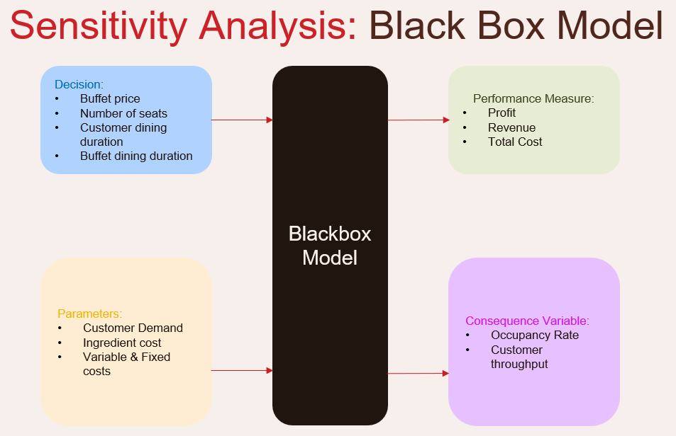
Module 1: Business Resilience and Pricing Optimization
Buffet Price
Revenue
Profit
Buffet Dining Duration
Occupancy Rate
Customer Throughput
Customer Dining Duration
Variable & Fixed Costs
Total Cost
No. of seats
Customer Demand
Ingredient cost

Slide 5
Module 1: Business Resilience and Pricing Optimization
Objectives: 1) To analyze how changes in uncontrollable factors (Cost, Demand) affect the model’s main output (Profit). 2) Evaluating and comparing performance measures (Revenue, Total Cost) when current controllable factors changes. Determine best price to set based on business pricing to obtain optimal profit.
Assumptions made for Models
Base price and Dining
Lunch and Dinner pricing are obtained from industry 5* hotel prices and averaged to represent the model’s weekday and weekend prices.
1.5hrs used for customer dining duration where customers will stay for the entire duration
Costs
Fixed, variable and ingredient cost is obtained for average % from industry based on revenue.
Occupancy Rate
Occupancy rate is based on how many customers will occupy each seat during the whole day.
Excel Workings
Demand Curve
Graphs is based on weekday and weekend prices as a whole. (Lunch + Dinner averaged and combined)
For every $10 price increase, weekday demand drops by 5% and weekend demand drops by 4%.
Equation of curve will be linear.
Sensitivity Analysis
Percentage change of each cost will be by increment/decrements of 1%.
Tradeoff Analysis
Only best price for profit will be calculated instead of buffet/customer dining duration and no. of seats to lead of to next Module.

Slide 6
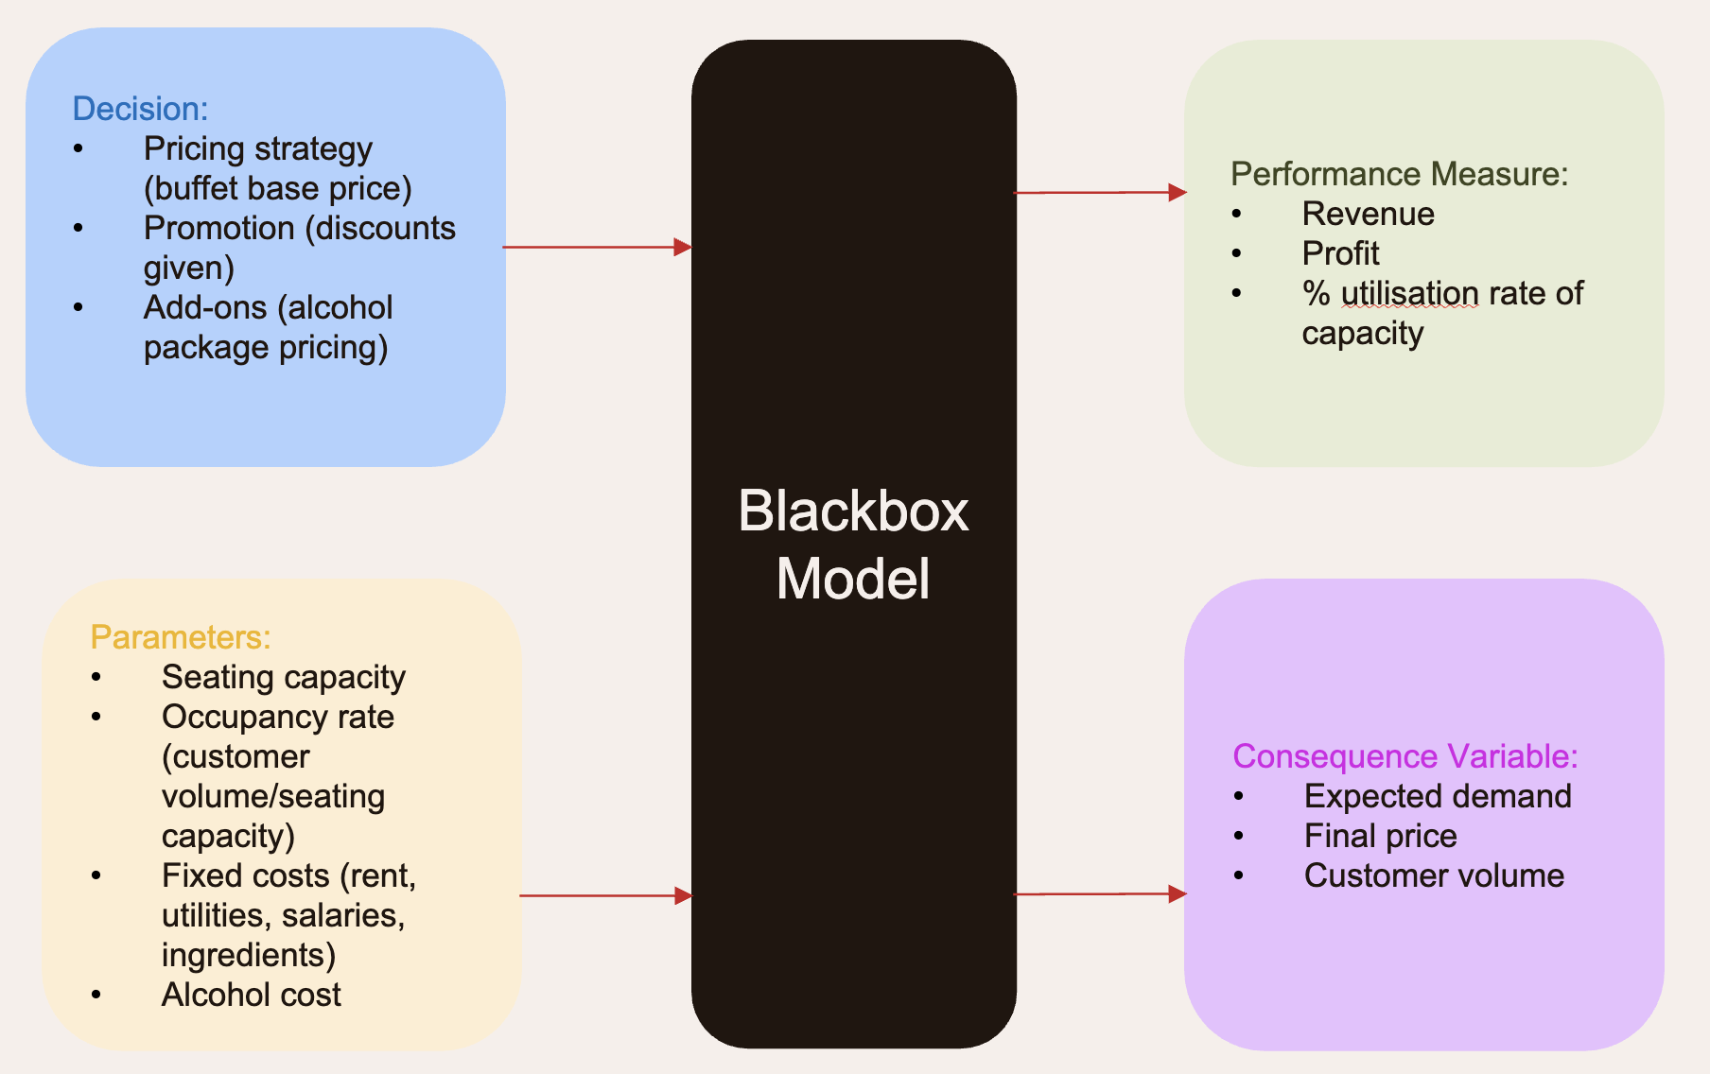
Module 2: Marketing Pricing Strategy
% utilisation rate of capacity
Promotion (discount given)
Final price
(after promo)
Expected Demand
Customer volume
Revenue
Profit
Seating capacity
Occupancy rate
Fixed costs
Buffet price
Alcohol package
Alcohol costs

Slide 7
Module 2: Marketing Pricing Strategy
Assumptions made
Base price
Fixed base price per category e.g. weekday vs weekend vs holiday (based on sensitivity analysis on best price)
Weekends and holidays have the same base price
Costs (fixed)
Fixed cost (as % of max revenue): 7.5% Full Timers, 17.5% rental
Variable cost (as % of total revenue): 31.5% ingredient cost, 5.5% Part Timers, 5% utilities
Alcohol cost fixed rate (as % of alcohol revenue): 30%
Operations
Daily occupancy rate per seat consistent across weekday, weekend and holiday (based on same rates as sensitivity analysis), based on same operating hours
Demand (buffet)
Holidays >= weekends > weekdays
Dinner > lunch
Demand (alcohol)
Differing alcohol uptake rate across each session, where:
Alcohol uptake rate: holiday > weekend > weekday
Alcohol uptake rate: dinners > lunches
Price elasticity of alcohol:
Relatively more elastic during weekdays and lunches i.e. customers more price sensitive
Relatively less elastic during dinners, weekends and holidays dinners i.e. customers less price sensitive
Excel workings
Calculator for each scenario (lunch and dinner across weekday, weekend and holiday), calculating the demand, revenues, costs and profit
Data table for each scenario to show the profit margin across different buffet discounts and alcohol pricing

Slide 8
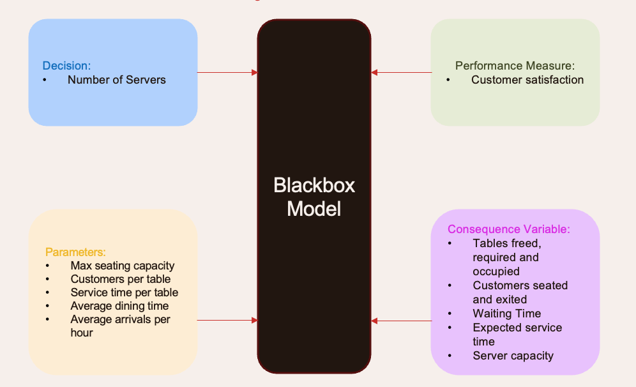
Module 3: Customer Satisfaction
Number of servers
Service time per table
Server capacity
Average dining time
Pax exited
Tables freed
Customers per table
Tables Required
Pax Seated
Waiting time
Customer satisfaction
Base Average Arrivals
Arriving Customers
Scenario Factor
Max seating capacity

Slide 9
Module 3: Customer Satisfaction
Assumptions:
Seating and Capacity
One table only can fit a maximum of 4.
Every party, even if less than 4 is treated as requiring/freeing 1 table to account for no one seated with strangers from another group.
Seats are immediately available upon clearing
Dining & Services Time
Each server is available in the defined 10 minutes time bucket and works continuously at full capacity.
Service time is calculated for each table, not per customer with a duration of 5 minutes.
Based on research, less than 5 minutes of waiting time is considered good customer satisfaction.
Arrivals & Queue
All waiting customers stay in queue until seated, no one leaves the queue.
Arrivals follow an exponential distribution with a factor included depending on scenario.
Only dinner is modelled as it assumes that lunch would have lower occupancy, so number of servers during dinner would naturally be more.
Excel Workings:
Monte Carlo simulation of exponential distribution to randomize the arrivals
What-if Analysis’ Data Table to generate the average wait time at different number of servers (1 – 30)
Run 1000 simulations to stabilize the results under different scenarios
Find the first quantity of number of servers that reaches < 5 minutes to keep manpower cost low, maximizing profit.
Average out the number of servers across all scenarios to find a baseline number of servers to achieve customer satisfaction.

Slide 10
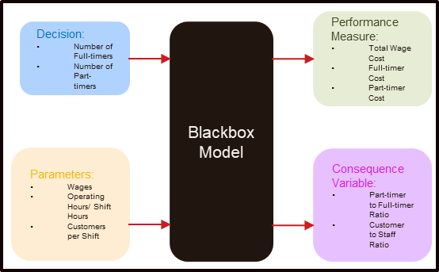
Module 4: Manpower Optimization
Full-timer Cost
Number of Full-timers
Kitchen Crew
Service Crew
Number of Part-timers
Kitchen Crew
Service Crew
Operating Days/ Shift Hours
Wages
Monthly (Full-timers)
Hourly (Part-timers)
Part-timer Cost
Total Wage Cost
Part-timer to Full-timer Ratio
Customer to Staff Ratio
Customers per Shift
Lunch
Dinner
Solver

Slide 11
Module 4: Manpower Optimization
Assumptions Made for the Model:
Staffing/ Operations :
Set a Customer to Staff Ratio for customer satisfaction - Customer to Service Crew/ Kitchen Crew
For Service Crew – More Part-timers than Full-timers for staff flexibility (set a min-max PT:FT ratio)
Same no. of Full-timers work for both shifts, no. of Part-timers can vary for both shifts
For Full-timer staff: 6 day work week – Approximate no. of off days using a Utilisation Rate
Min. no of Full-timers crew to support operations
Assume no OT for Staff
Part-timer Wages – Per Hour, 1.5x for Weekend, 2x for PH
Full-timer Wages – Per Month
Excel Working:
Calculator for Total Wage Cost in a selected month
Solver to set the Total Wage Cost to minimum by adjusting no. of staff as input
Data Table to show Total Wage Cost for each month in 2025
No. | Requirements | Solver Constraints Set
1 | No. of staff need to be a positive integer value | Set integer constraint for input cells for staff numbers Min. no. of Full-timers – prevent -ve values
2 | Target Customer to Staff Ratio (For service and kitchen crew respectively) | Customer to Service Crew Ratio (per lunch and dinner) Customer to Kitchen Crew Ratio (combine both shifts)
3 | Part-timer to Full-timer Ratio Full-timer’s 6 day work week | Min. no of Effective Full-timer (using utilization rate) for each role Set Min and Max PT to FT Ratio

Slide 12
Insights and recommendations
Customer Satisfaction: To maintain average wait times below five minutes, we recommend staffing a baseline of 17 servers for regular dinner service. During peak‐demand scenarios such as promotional events on public holidays, the server count should increase to at least 21. Conversely, to optimize labour costs during off-peak periods (for example, weekday services with lower patronage), the hotel can reduce its servers accordingly.
Optimizing Manpower: To optimise the number of staff by minimizing wage cost while maintaining specified requirements to maintain customer satisfaction and service crew flexibility – we recommend to have a service crew of 4 full-timers and 13 part-timers together with a kitchen crew of 8 full-timers
Business Resilience and Pricing Optimization: For changes in demand and total cost, weekday profit is more sensitive to price-demand change while weekend profit is more sensitive to each individual changes to cost. Thus, based overall business challenges these models aims to provide an estimate on how much profit is gained/loss.
At the same time, based on the evaluating different buffet prices for Weekday and Weekend. The most optimal buffet pricing based on business conditions would be $115 and $164.50 respectively. (Old price: $85, $94.50)
Marketing Pricing Strategy: To achieve a good profit margin while maintaining a minimum of 70% utilisation rate of capacity, these are the optimal discounts + alcohol pricing:
 | Weekday - Lunch | Weekday - Dinner | Weekend - Lunch | Weekend - Dinner | Holiday - Lunch | Holiday - Dinner
Discount (%) | 40 | 20 | 20 | 10 | 10 | 0
Alcohol price ($) | 35 | 45 | 40 | 50 | 50 | 60
Profit Margin | 6.73% | 16.65% | 30.95% | 37.59% | 33.81% | 39.15%
% utilisation rate of capacity | 73.4% |  | 78.6% |  | 71.9%

Slide 13







Thank you!

